Slide 1
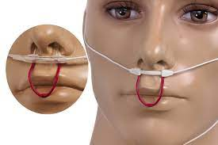
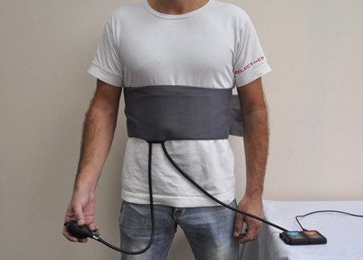
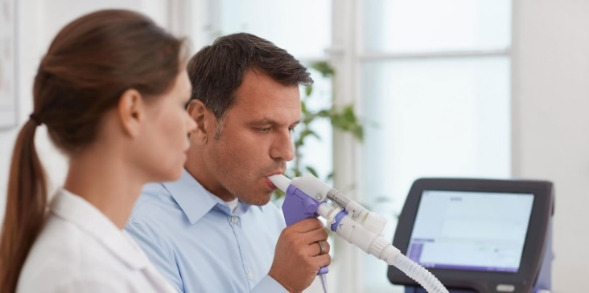
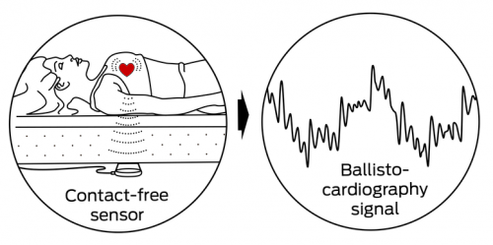
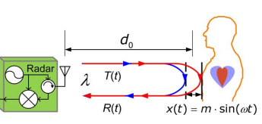
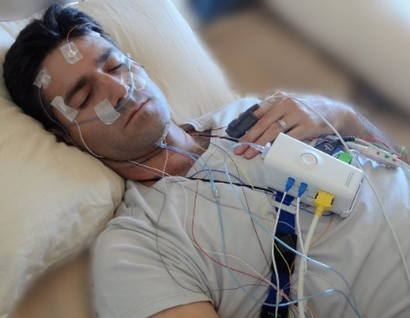
Remote healthcare: Can we bring care to home ?
Nasal Airflow Probe
Chest belt
Spirometry
Ballistocardiogram
(BCG)
Doppler Radar
Polysomnography
(PSG)
Notes:
With the ongoing COVID-19 pandemic, telemedicine has become a promising tool to realize remote healthcare.
Airflow probes: uncomfortable, chest belts requires constant tension on abdomen or thorax, Spirometry requires attentive user participation.
Non-invasive monitoring methods, BCG: Posture variation and movement on bed are problematic as well.
other RF sensors: s require stationary , in a direct line-of-sight (LoS) to the front torso.
Despite of high accuracy by PSG, high cost and scarce availability in clinics, and uncomfortable.

Slide 2
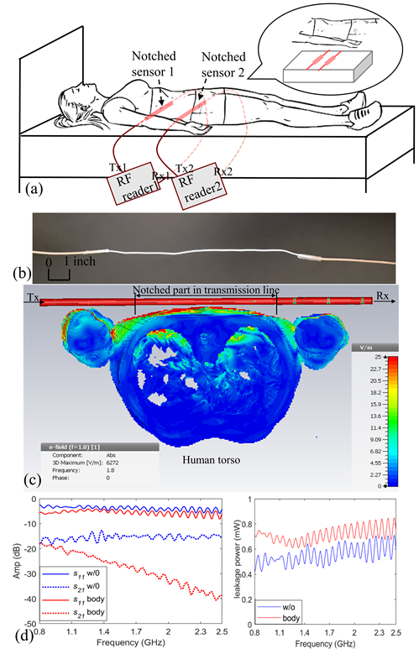
Non-invasive and continuous monitoring on physiological signals
Near-field Coherent Sensing (NCS)
Couple EM wave to dielectric boundary movement by internal organs to get vital signs and other biomedical signals.
Respiration, Heartbeat, Muscle activity, Tissue motions ….
c
Simulation of Electromagnetic coupling of (a) front of human torso ,(b) wrist and (c) cross section of human torso.
Notes:
Non-invasive touchless and continuous
NCS couples electromagnetic (EM) waves inside the body and reads out the internal organ and tissue signals as modulated antenna characteristics or scattering impedance matrices

Slide 3
Experimental setup
We present a new respiration sensor integrated into a bed or a chair by modifying a radio-frequency (RF) coaxial cable structure with a designed notch. The lung motion is coupled to the electromagnetic leakage at the notch through near-field coherent sensing (NCS).
Notched-cable respiration sensor setup: (a) System schematic with bed integration; (b) A photo of the notched cable
Experimental setup of the notched sensors

Slide 4
Benchmark with BIOPAC tension belts
Respiration monitoring in the supine posture with f_{RF} = 900MHz:
NCS and BIOPAC amplitude waveforms in thorax and abdomen during the whole breathing protocol.
(b) Th breath rate (BR) calculated from NCS (green) and BIOPAC (red).
(c) Correlation and agreement between NCS and BIOPAC BR data. Left: The scatter plot with denoted Pearson’s correlation coefficient. Right: The Bland-Altman plot showing the mean difference m at the center dotted line and the corresponding limits of agreement (LoA) at the upper and lower dotted lines given by m±1.96σ.

Slide 5
Heart rate (HR) detection
Left: The heartbeat time-domain waveforms from the thorax sensor during normal breathing. Right: The corresponding spectrum with three HR peaks and two BR peaks indicated by the annotation above.
Left: The heartbeat waveforms during breath hold. Right: The corresponding spectrum with three peaks.
The thorax NCS sensor can also retrieve the heart rate (HR) with reasonable accuracy.
The signal was first filtered by a bandpass filter between 0.1 – 5 Hz to remove the DC component and high-frequency noise.

Slide 6
Isovolumetric exercise
The isovolumetric exercise was represented by paradoxical motion between thorax and abdomen.
Simulated Sleep Apnea
Isovolumetric detection: (a) Respiration waveforms from thorax (red line) and abdomen (green line) sensors during three isovolumetric breathing exercises. (b) Detection by the slope-product method: The blue solid line by the NCS sensor and the orange dotted line from protocol annotation, where –1 indicates detection.

Slide 7
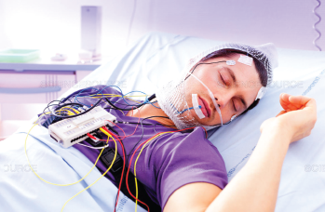
Non-invasive Sensing Vital Signs
To invisible sensing
high user comfort,
worn over cloth, or invisible to user
by furniture integration.
cost-effective, compact
keep long-term and continuous recording data and provide real-time feedback for early warning and diagnosis
Notes:
Non-invasivee respiration sensors integrated into furniture can be invisible to the user and greatly enhance comfort and convenience to facilitate many applications.
The proposed radio-frequency (RF) sensor can be worn over clothing or completely invisible to the user with the least concerns of discomfort and awareness. It can be integrated into cloth, a bed, or a chair, hidden behind layers of fabrics. The senor can be cost-effective, compact, stable and compatible to various digital wireless protocols.
EMG measures electric activity of muscle, invasive, needles inserted into body, or non-invasive on surface, direct skin contact.
susceptible to various types of noises, motion interference, ECG artifacts, ambient noise
RMG is touchless, sensitive to muscle motion, more resistant to interference, can capture deep muscle motion

